Slide 1

Hungary Chickenpox Case Analysis
Time Series Project
Team 9

Slide 2





Our Team
Pujing Yang
Yuqing Jin
Jeffrey Chen
Kaihao Fan

Slide 3
TABLE OF CONTENTS
PROBLEM STATEMENT
1
2
DATA PROFILE
EXPLORATORY DATA ANALYSIS
3
4
TIME SERIES MODELS
MODEL VALIDATION & SELECTION
5
6
CHALLENGES
FUTURE WORK
7

Slide 4

Problem Statement
The Chickenpox is an infection caused by the varicella-zoster virus. It causes an itchy rash with small, fluid-filled blisters. Chickenpox is highly contagious to people who haven't had the disease or been vaccinated against it. With the provided dataset for chickenpox cases from Hungary counties, it is possible to understand and assess chickenpox spread trending in those specific areas and even Hungary as a whole. By accurately predicting future cases, the local government can allocate medical resource and distribute vaccination more efficiently.

Slide 5
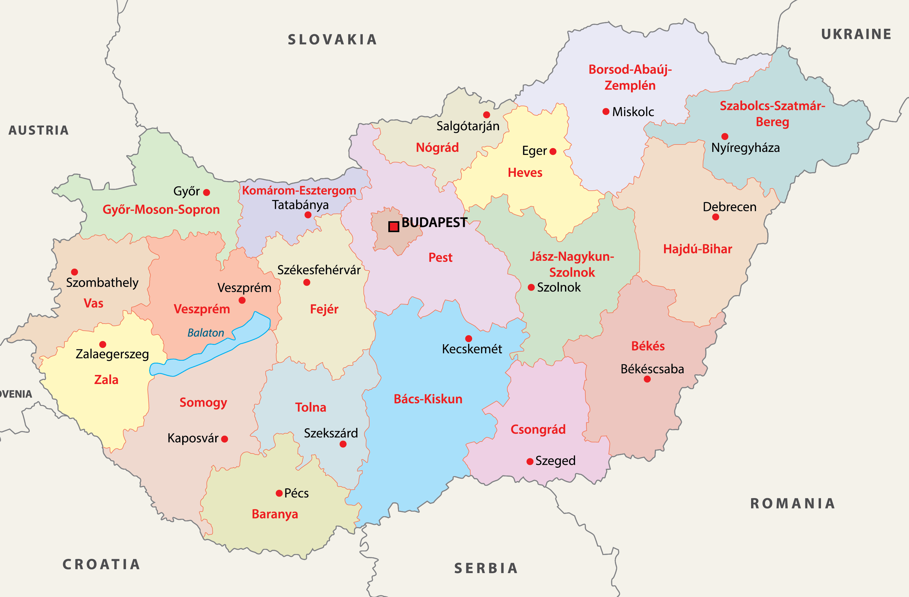

DATA PROFILE
BUDAPEST
BARANYA
BACS
BEKES
BORSOD
10 Years
CSONGRAD
FEJER
GYOR
HAJDU
HEVES
20 Counties
JASZ
KOMAROM
NOGRAD
PEST
SOMOGY
SZABOLCS
TOLNA
VAS
VESZPREM
ZALA
2005 - 2015
* Data is accurate & No need to validate

Slide 6
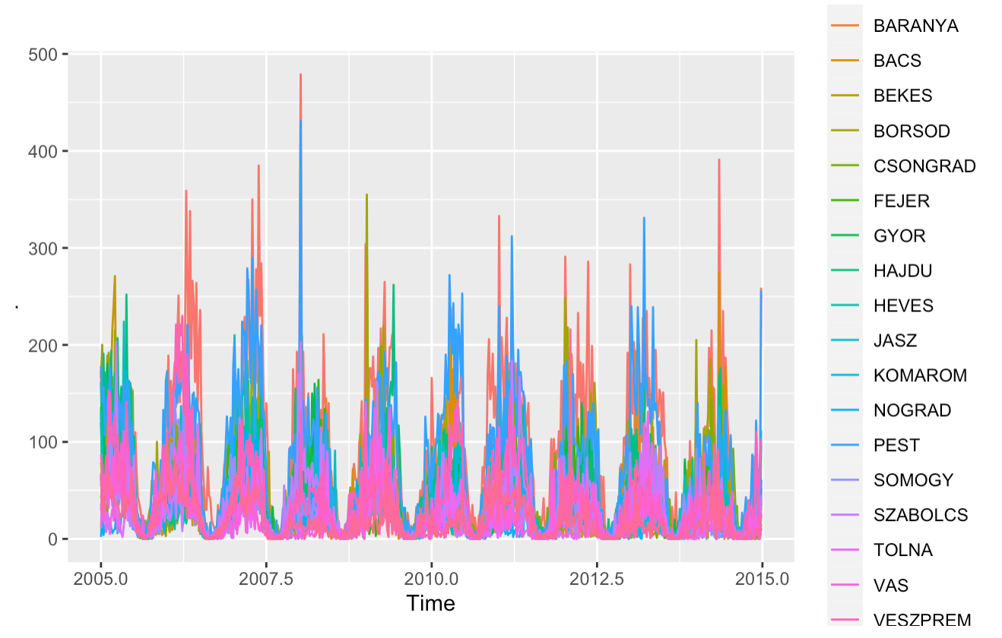
Exploratory Data Analysis

Slide 7
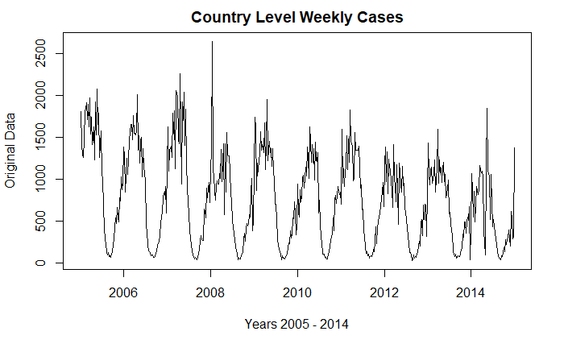
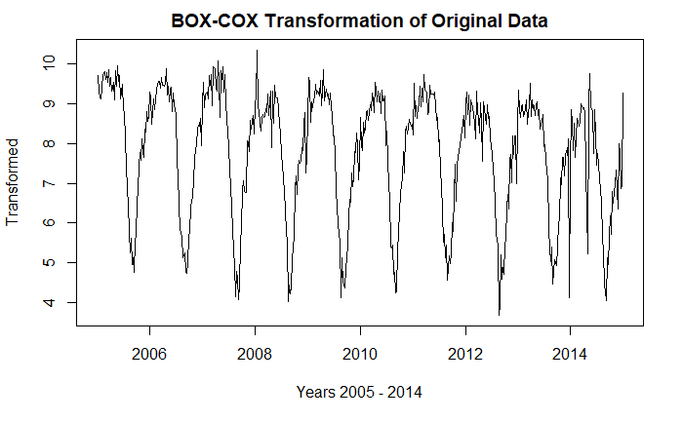
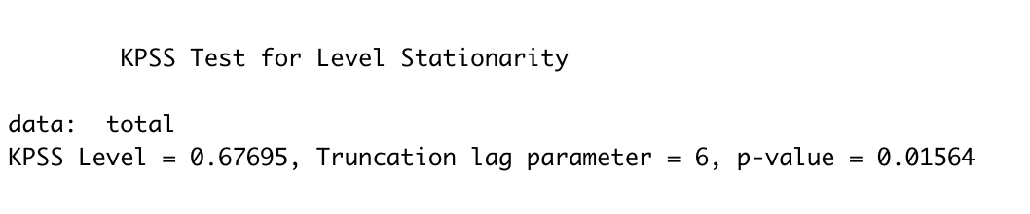
DE-TRENDING
BOX-COX TRANSFORMATION
Lambda λ = 0 (natural log)

Slide 8
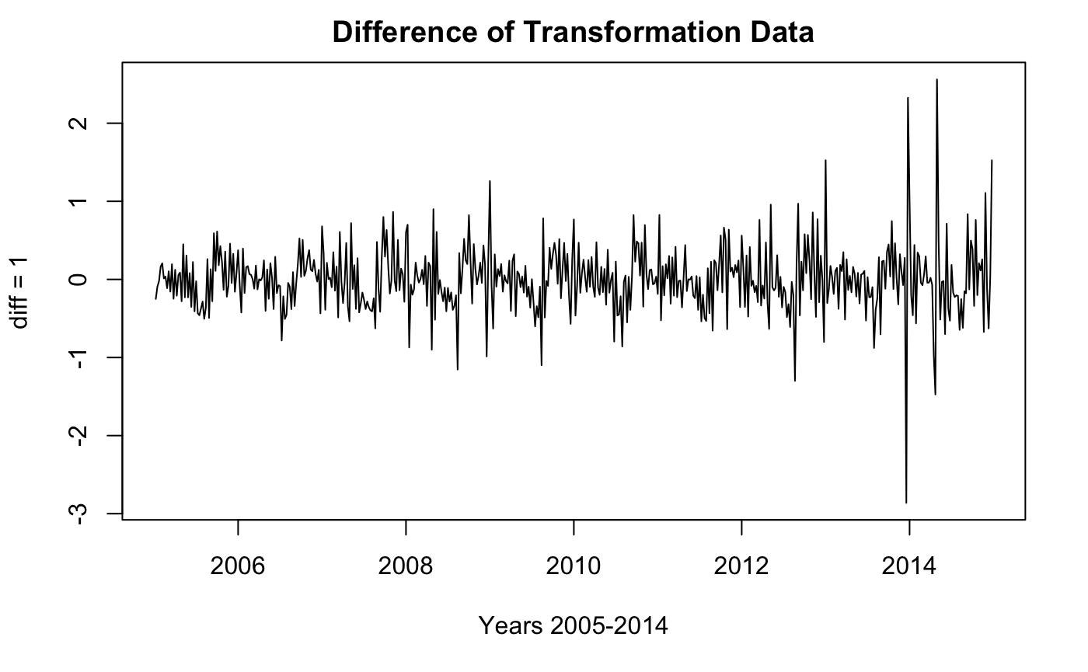
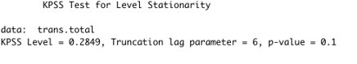
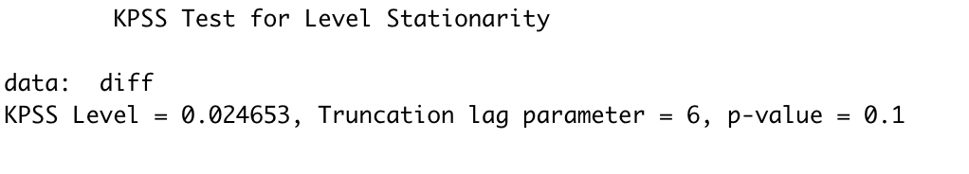
DE-TRENDING
DIFFERENCING

Slide 9
Time Series Models

Slide 10






DIVIDE APPROACH
Auto ARIMAs
Auto ARIMAs
Fourier
ARIMAs
Fourier
ARIMAs
TBATs
TBATs
TRAIN
FIT
PREDICT
SUM
TEST
Notes:
The first approach is what we called divide and conquer approach . 111111111As the name suggests, after we first split the train & test data, 22222222we fit the model to each counties individually. So, we have about 20 models for each type of model we tried. Over here, we select three models, they are auto arimas, Fourier Arimas and TBATs. The reason being is that all three models can handle non integer frequency. To be specific, we have years that are 52 weeks and we have years that are 53 weeks. In this case, we just use a decimal frequency which is 52.177 week per year without the need of dropping any data. 3333333, the fourth step is to make our prediction forecast one year ahead for each of the model. 444444 and Finally, we sum up all the predicted result and compare it to the test data for scoring. To summarize, since we are building 20 multiply by 3 which is 60 models, this approach appears to be very computational intensive, but this method utilize every piece of data we have, it is a very reliable approach to try.

Slide 11
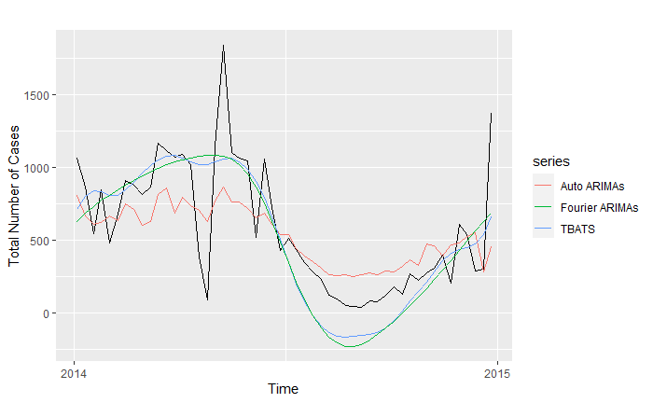

DIVIDE APPROACH
RMSEs
Auto ARIMAs
286.36
TBATs Model
280.62
Fourier ARIMAs
296.01
MSEs
Auto ARIMAs
82003.94
TBATs Model
78745.31
Fourier ARIMAs
87620.37
Notes:
Here is the cross comparison for each of the model I tried. As we can see from the graph, auto arima does a really good job at capturing the small tweaks. For example, the red line around march and October of 2014 has very similar shape compare to the test dataset. In contrast, TBATs & Fourier ARIMAs has very similar looking and they all capture the seasonality component very well. However, TBATs clearly wins at scoring since it did a better job at capturing the small turnings despite that the spike around April and December hurt the model the most. Now give it to Jeffery to talk about the second approach.

Slide 12
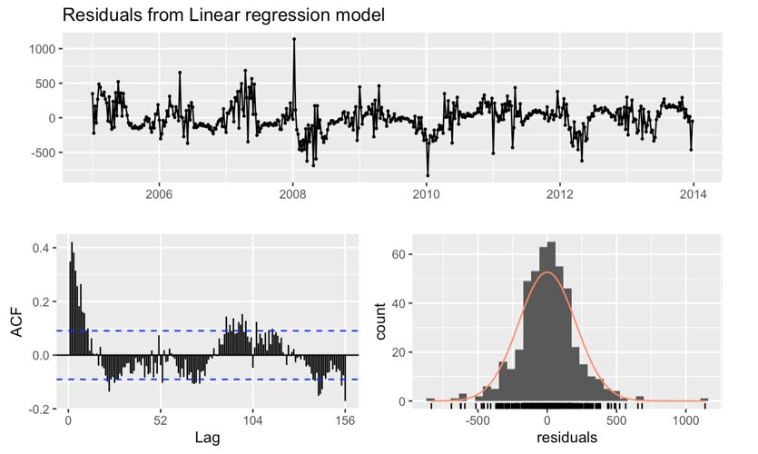
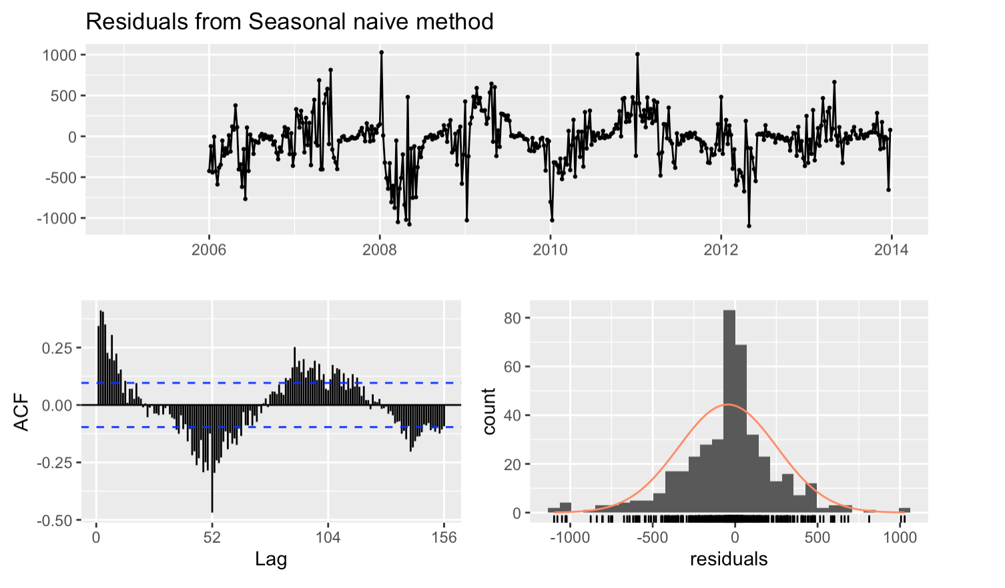
Combined Approach
Ljung-Box test
P-value = 2.2e-16
MAPE
35.15
RMSE
301.20
Ljung-Box test
P-value = 8.657e-15
MAPE
40.91
RMSE
205.60
Notes:
autocorrelation

Slide 13
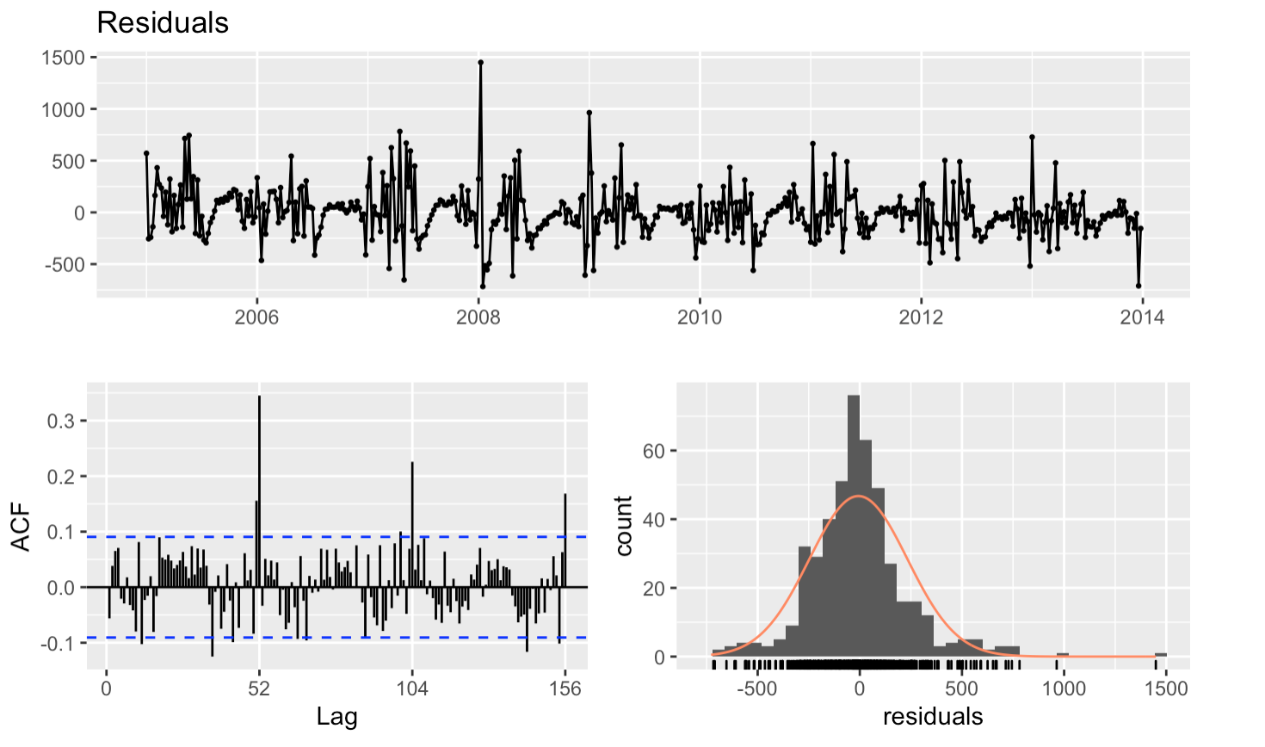
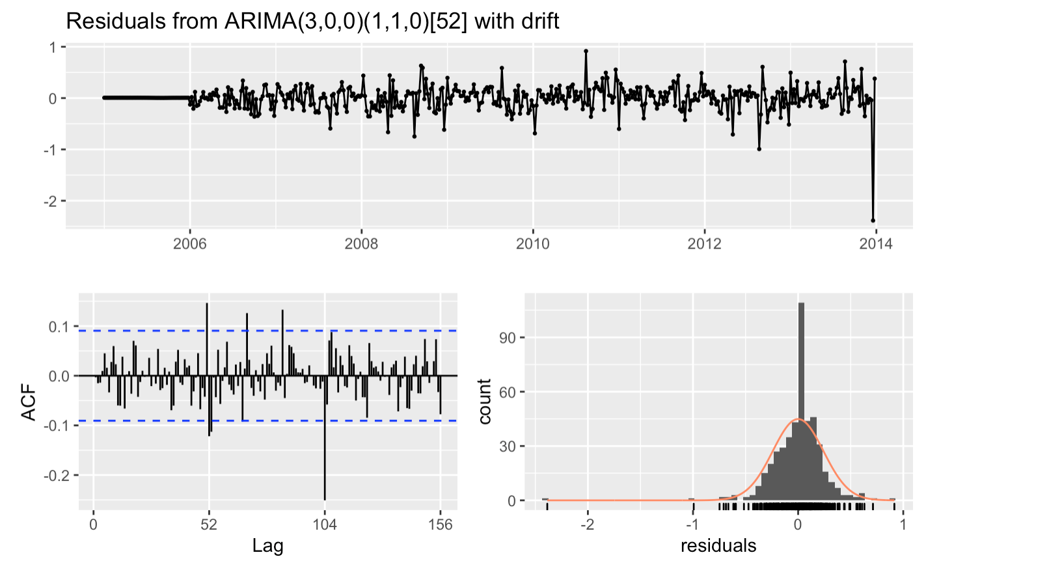
Combined Approach
Residuals from ARFIMA(3,0.163,3)
Ljung-Box test
P-value = 0.1234
MAPE
23.80
RMSE
209.92
Ljung-Box test
P-value = 0.2227
MAPE
39.22
RMSE
240.23
Notes:
autocorrelation

Slide 14
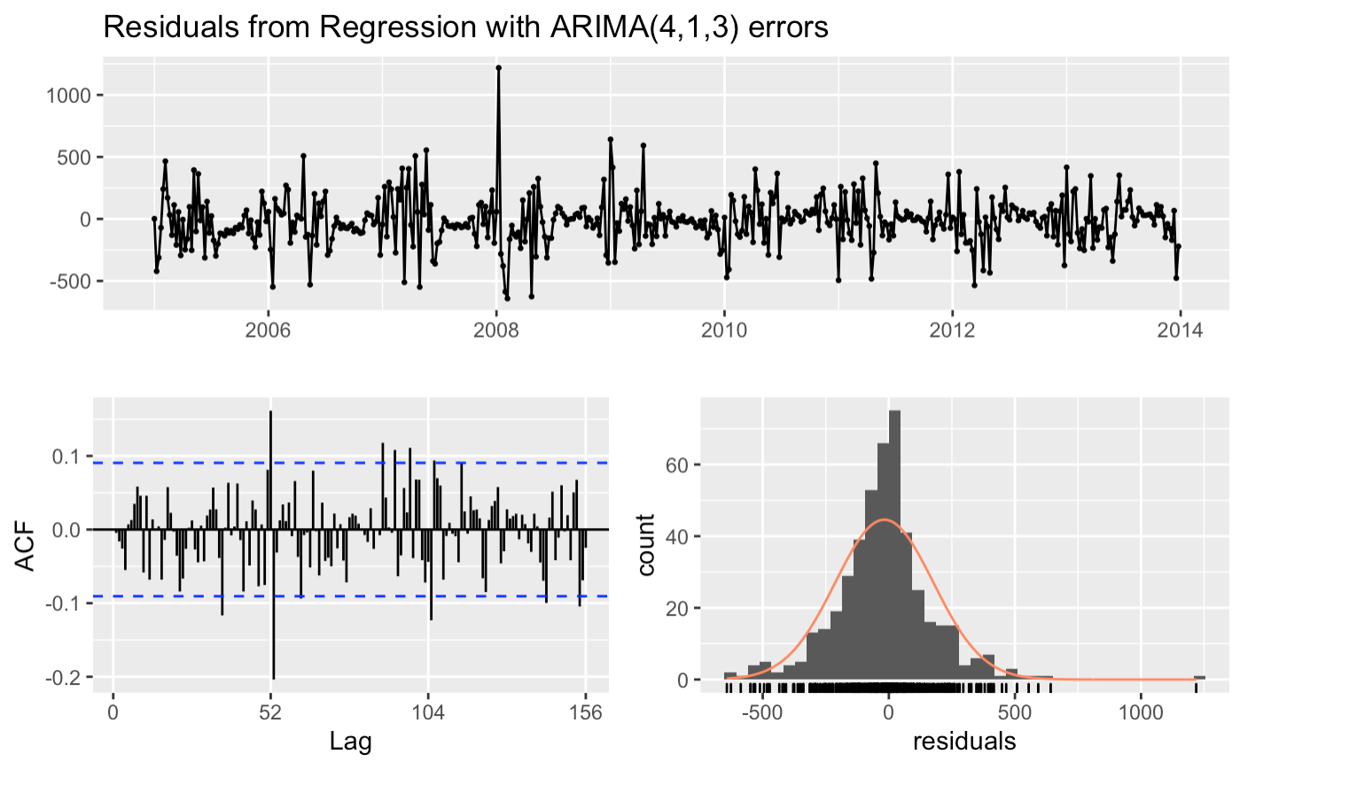
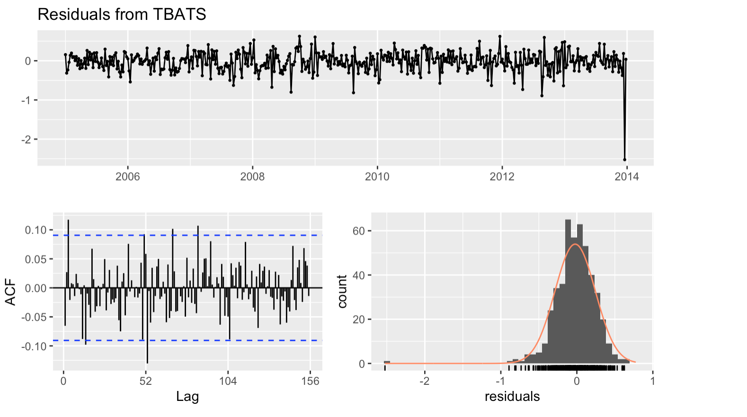
Combined Approach
Ljung-Box test
P-value = 1.697e-05
MAPE
21.32
RMSE
192.57
Residuals from TBATs(0.005, {0,0}, 0.908, {<52, 13>})
Ljung-Box test
P-value = 2.133e-09
MAPE
28.56
RMSE
195.39
Notes:
autocorrelation

Slide 15
MODEL COMPARISON
METRICS ON TRAINING | SEASONAL NAÏVE | SARIMA | ARFIMA | TBATS | FOURIER ARIMA | TSLM
MAPE | 35.15 | 23.80 | 39.22 | 21.32 | 28.56 | 40.91
RMSE | 301.20 | 209.92 | 240.23 | 192.57 | 195.39 | 205.60

Slide 16
Model Selection and Validation

Slide 17
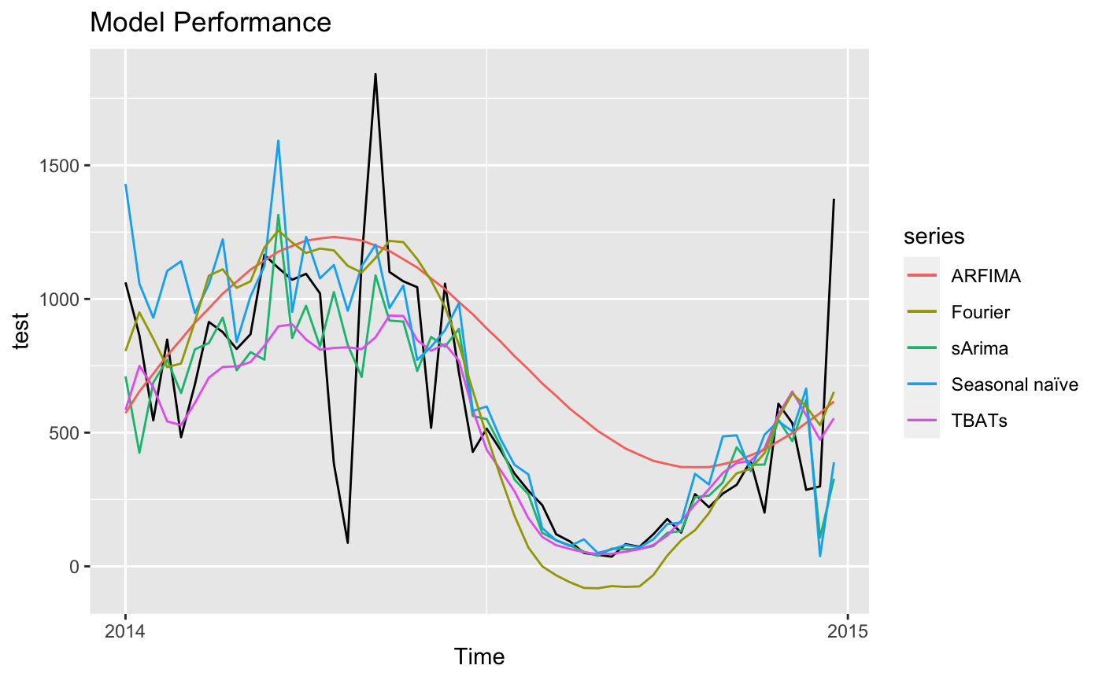
Combined Approach
Metric | MAPE | RMSE
sArima | 45.44 | 281.25
ARFIMA | 175.07 | 371.34
Seasonal naïve | 56.57 | 301.56
TBATs | 45.28 | 266.62
Fourier | 85.99 | 285.43
tslm | 102.86 | 313.36

Slide 18
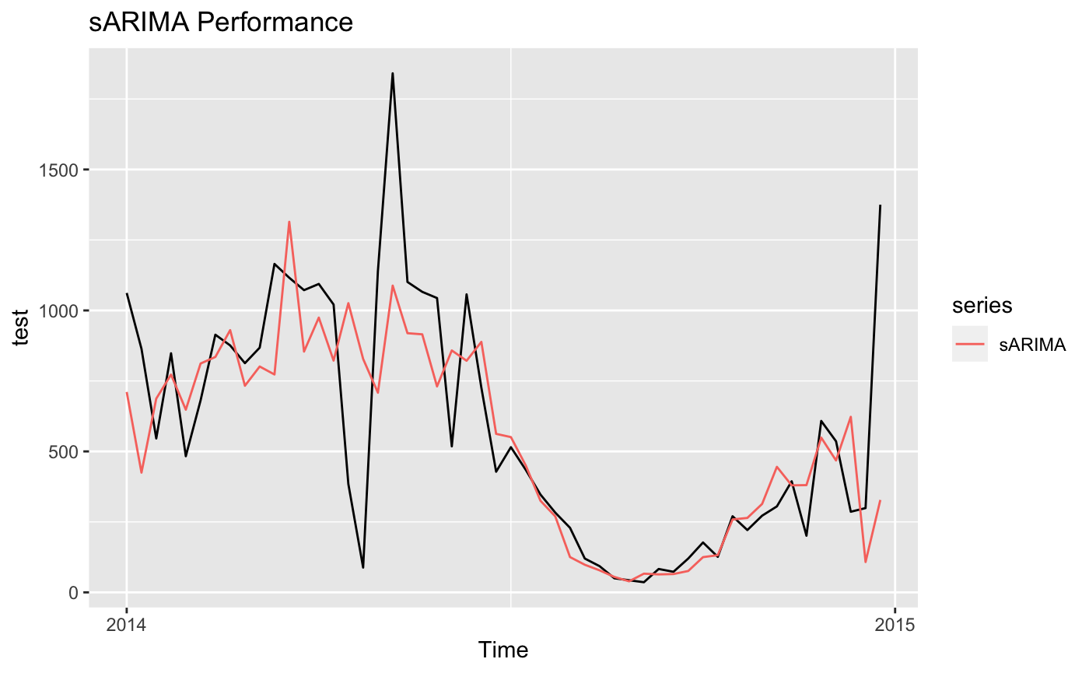
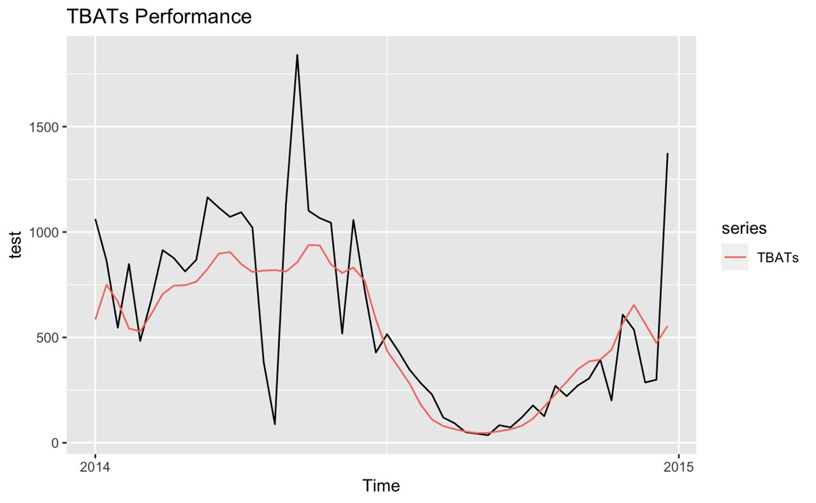
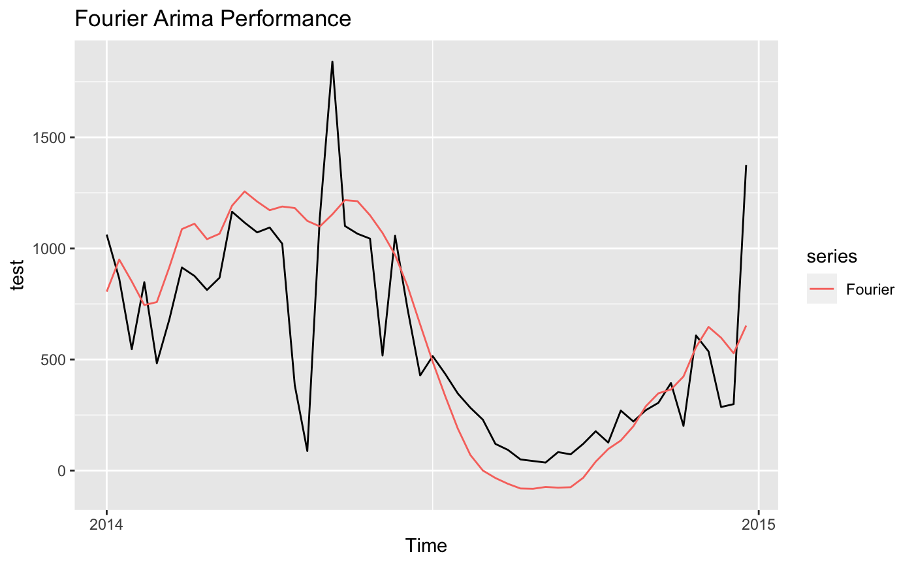

Slide 19


Non-Integer Frequency
Challenges
Spikes in Data
522 weeks for 10 years data with frequency 365.25/7
(Seasonal Naïve, ARIMA and sARIMA)

Slide 20
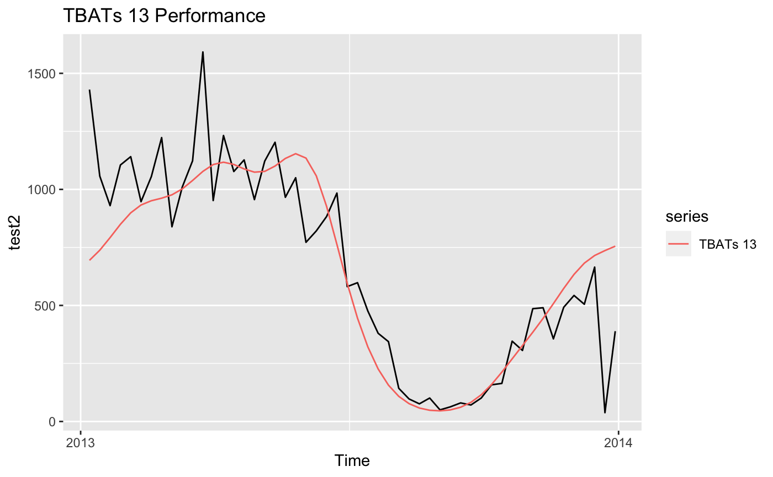
Spikes Impact
Check with Year 2013
RMSE
211.49
Ljung-Box test
P-value = 0.005396
MAPE
56.09
RMSE
266.62

Slide 21
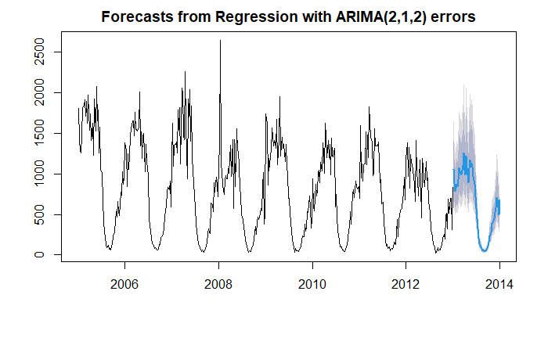
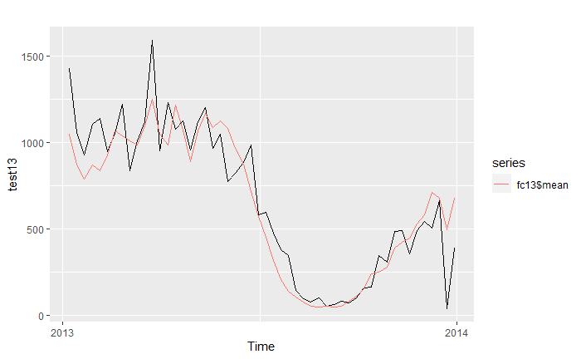
Train until 2012 and Test with 2013
RMSE
160.34
Ljung-Box test
P-value = 2.969e-07
MAPE
42.30
RMSE
285.43

Slide 22
Future Work

Slide 23
1
VALIDATE DATA
Crest & Trough
2
INVOLVE EXTRA INFO
3
INTERVENTION ANALYSIS
Forecast Periods
4
Train
CROSS VALIDATION
Cross Validation
Test
2005
2006
2007
2008
2009
2010
2011
2012
2013
2014

Slide 24
THank you

Slide 25
Q&A

Slide 26
Appendix

Slide 27
Seasonal Arima Model
Ljung-Box test
P-value = 0.1234
RMSE
209.92
MAPE
23.80

Slide 28
ARFIMA Model
Residuals from ARFIMA(3,0.163,3)
Ljung-Box test
P-value = 0.2227
RMSE
240.23
MAPE
39.22

Slide 29
TBATs Model
Residuals from TBATs(0.005, {0,0}, 0.908, {<52, 13>})
Ljung-Box test
P-value = 1.697e-05
RMSE
192.57
MAPE
21.32

Slide 30
Fourier Model
Ljung-Box test
P-value = 2.133e-09
RMSE
195.39
MAPE
28.56

Slide 31
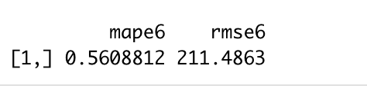
Train until 2012 and Test with 2013
Ljung-Box test
P-value = 0.005396
MAPE
56.09
RMSE
211.49

